Slide 1
Load Balancing and Scheduling
CS121 Parallel Computing
Spring 2018

Slide 2
Load balancing problem
Goal is to finish a set of tasks as quickly as possible.
Requires resources don’t idle, i.e. do similar amounts of work.
Load balancing decides which tasks to perform on which processors.
Scheduling decides the order of tasks, which affects fairness, responsiveness, etc.
Load balancing and scheduling have a vast literature in parallel and distributed computing, operating systems, operations research, etc.
Many different models for computation and communication, precedence constraints, heterogeneous systems, etc.
Many packages available, e.g. Zoltan, Cilk, Chombo, ParMetis.
For most scheduling problems, finding optimal solution is intractable.
Goal of load balancing is speed, so load balance algorithm itself needs to be fast.
Rely on fast heuristics that work well in practice or have approximate performance guarantees.

Slide 3
Static vs dynamic
Some applications are static, i.e. the set of tasks in the application, their sizes and communication pattern are known at the start of the execution.
Ex Dense and sparse linear algebra, FFT.
Load balancing can be done once at beginning of computation.
Can afford to spend more time to get higher quality solution.
For semi-static problems, task information is known periodically at start of some phases.
Ex Particle simulations, grid computations.
Periodically rebalance when load changes substantially.
Requires relatively efficient algorithm.
For dynamic problems, information is only known at runtime.
Ex Search problems.
Constantly rebalance on the fly. Need very lightweight methods.
Can load balance at different granularities.
Fine grained task balancing gives best results, but may take too much time and memory.
Can group tasks together for coarse graine balancing.

Slide 4
Centralized vs distributed
Centralized load balancing gathers all information at one node.
Produces better result since global load info available.
Central node becomes performance bottleneck.
Distributed load balancing lets nodes communicate and make own balancing decisions.
More scalable. Can react faster to load changes.
Hard to achieve globally optimal result.
May be slower than centralized if multiple balancing steps required.
Hierarchical scheme uses centralized node for coarse grained load balancing, then uses distributed nodes for fine grained balance.
Ex First assign groups of tasks to nodes, then divide each group among the processors.

Slide 5
Other issues
Load estimation tries to predict the load and communication pattern of a task.
In best case, this can be inferred from the code.
Otherwise, can profile the task, and assume its future behavior matches the past.
Information gathered automatically, without user intervention.
Ex Works well for some scientific computations and simulations.
Alternatively, can build a model for the task behavior.
Labor intensive. Must update model if program changes.
When load changes, can rebalance by migrating tasks from one node to another.
May be costly, because need to move code and possibly data.

Slide 6
Static load balancing
Start with a basic model where task sizes are known, there are no precedence constraints between tasks, and ignore communication costs.
Even in this model optimal scheduling is NP-hard.
n independent tasks with different sizes.
Tasks can be done in any order.
Any task can be done on any processor.
m processors with the same speed.
Each processors can do one task at a time.
Minimize the makespan, i.e. time when last processor finishes.
makespan
p₁
p₂
m CPU’s
p₃
p₄
time

Slide 7
Minimizing makespan is NPC
Show that minimizing makespan on even two processors is NP-complete.
Decision version of problem is in NP.
SUBSET-SUM problem: Given a set of numbers S and target t, is there a subset of S summing to t?
Ex S={1,3,8,9}. For t=9, yes. For t=14, no.
SUBSET-SUM is NP-complete. Will reduce it to 2 processor makespan scheduling.
Let (S,t) be an instance of SUBSET-SUM, and let s be sum of all elements in S.
Make a set of tasks J = S∪{s-2t}, and schedule them on 2 processors.
Show that SUBSET-SUM reduces to min makespan, i.e. SUBSET-SUM has a solution iff min makespan has a certain solution.

Slide 8
Minimizing makespan is NPC
Claim If some subset of S sums to t, then min makespan is s-t.
Proof Say S’⊆S sums to t. Schedule the tasks in S’ and task s-2t on processor 1. So processor 1 finishes at time t+s-2t=s-t. Processor 2 does the tasks in S-S’, so it finishes at time s-t as well. Since processors finish at same time, the makespan is minimal.
Claim If the min makespan is s-t, there exists a subset of S that sums to t.
Proof Suppose WLOG processor 1 does the s-2t task. Since makespan is s-t, the other tasks processor 1 does must have total size s-t-(s-2t)=t.
So (S,t) is yes instance of SUBSET-SUM iff minimum makespan = s-t, so minimizing makespan is NPC.

Slide 9
List scheduling
Since scheduling is NPC, it’s unlikely we can find the min makespan in polytime.
List scheduling (Graham) is a simple greedy algorithm that finds a schedule with makespan at most twice the minimum.
Call this a 2-approximation.
If there are precedence constraints, we can modify list scheduling to allocate a task whenever it’s available, i.e. all its preceding tasks are finished.
This still gives a 2-approximation, but we won’t prove it.
List the tasks in any order.
While there are unfinished tasks.
If any processor is idle, give it the next task in the list.

Slide 10
Example
3 processors. The tasks have sizes 2, 3, 3, 4, 5, 6, 8.
List tasks in any order. Say 4, 5, 3, 2, 6, 8, 3.
All processors finishes by time 13, so makespan = 13.
p₁
4
6
p₂
5
8
p₃
3
2
3

Slide 11
Worst case for LS
How badly can list scheduling do compared to optimal?
Say there are m² tasks with length 1, and one task with length m.
Suppose they’re listed in the order 1,1,1,...,1,m.
LS has makespan 2m. Optimal makespan is m+1.
makespan(LS) / makespan(opt) = 2m/(m+1) ≈ 2.
This is worst possible case for list scheduling.
Thm Suppose the optimal makespan is M*, and LS produces a schedule with makespan M. Then M≤ 2M*.
m
m
m+1
m
m
makespan(LS) = 2m
makespan(opt) = m+1

Slide 12
LS is a 2-approximation
T
M
p₁
p₂
X
m
p₃
p₄
t
Suppose list scheduling produces above schedule.
Consider the task X that finishes last. Say X starts at time T and has length t.
Claim 1 M* ≥ t.
In any schedule, X has to run on some process.
Since X takes t time, every schedule, including the optimal, takes ≥ t time.

Slide 13
LS is a 2-approximation
T
M
p₁
p₂
X
m
p₃
p₄
t
Claim 2 M* ≥ T.
Up to time T, no processor is ever idle.
Up to T, there’s always at least one unfinished task, namely X.
As soon as a processor finishes one task, it’s assigned another one.
So at time T, each processor completed T units of work.
So total amount of work in all the tasks is ≥ mT.
So length of the optimal schedule is ≥ (total work)/m ≥ mT/m = T.

Slide 14
LS is a 2-approximation
T
M
p₁
p₂
X
m
p₃
p₄
t
From Claims 1 and 2, we have M* ≥ t and M* ≥ T.
So M* ≥ max(T,t).
M = T + t, because X is last task to finish.
So M/M* ≤ (T+t) / max(T,t) ≤ 2.

Slide 15
LPT scheduling
Worst case for LS occurred when longest job was scheduled last.
Large jobs can be “harmful” for schedule.
Let’s try to schedule longest jobs first.
Longest processing time (LPT) schedule is just like list scheduling, except it first sorts tasks by nonincreasing order of size.
Ex For three processors and tasks with sizes 2, 3, 3, 4, 5, 6, 8, LPT first sorts the jobs as 8,6,5,4,3,3,2. Then it assigns p₁ tasks 8,3, p₂ tasks 6,3, p₃ tasks 5,4,2, for a makespan of 11.
LPT has an approximation ratio of 4/3.
LS still has two advantages.
It can schedule tasks dynamically, as they’re generated on the fly.
It doesn’t need to know the sizes of the tasks.

Slide 16
LPT is a 4/3-approximation
Thm Suppose the optimal makespan is M*, and LPT produces a schedule with makespan M. Then M ≤ 4/3 M*.
Again, let X be the last job to finish. Assume it starts at time T and has size t.
We can assume WLOG that X is the last job to start.
If not, then say Y starts after T.
Y finishes before T+t. So we can remove Y without increasing the makespan.
Cor 1 X is the smallest job.
X is the last job to start, so due to LPT scheduling it’s the smallest.

Slide 17
LPT is a 4/3-approximation
Claim 1 LPT’s makespan = T+t ≤ M* + t.
As in LS, no processor is idle up to time T, so M* ≥ T.
Case 1 t ≤ M*/3.
Then LPT’s makespan ≤ M* + t ≤ M* + M*/3 = 4/3 M*.
Case 2 t > M*/3.
Since X is the smallest task, all tasks are > M*/3.
So the optimal schedule has at most 2 tasks per processor. So m ≤ 2n.
If 1 ≤ m ≤ n, then LPT and optimal schedule both put one task per processor.
If n < m ≤ 2n, then optimal schedule is to put tasks in nonincreasing order on processors 1,...,m, then on m,...,1.
LPT also schedules tasks this way, so it’s optimal.

Slide 18
Geometric load balancing
In many parallel applications, tasks have geometric coordinates, and nearby tasks communicate with each other.
Ex In a particle simulation, nearby particles interact.
Assume a static or semi-static setting, where tasks have same size.
We want to load balance and also minimize communication.
Want to place nearby tasks on same processor.
Still assume the task sizes are known.
Represent each task by a point at some coordinates.
Partition the points into m sets. Assign tasks in each set to one processor.

Slide 19
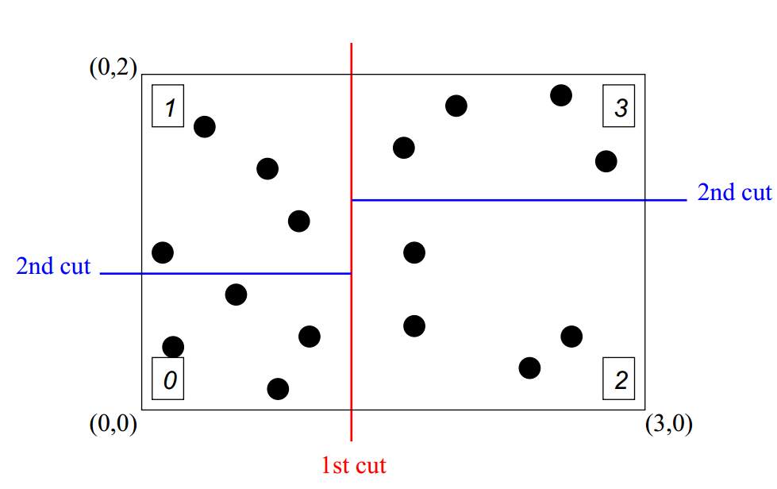
Recursive bisection
First partition tasks evenly in the x direction.
In each half, partition tasks evenly in the y direction.
In each quarter, partition tasks evenly in the x direction. Etc.
This might lead to partitions with large aspect ratios, causing many communicating tasks to lie in different partitions.
Source: New Challenges in Dynamic Load Balancing, Devine et al.

Slide 20
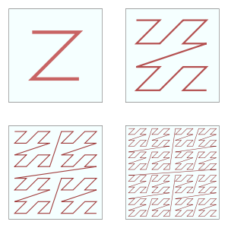
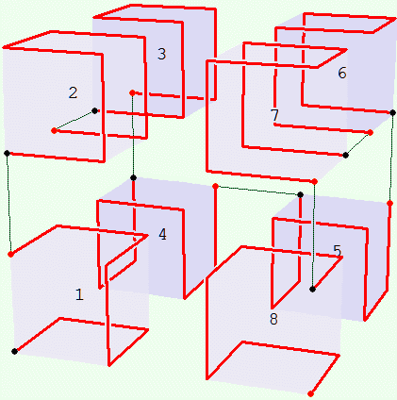
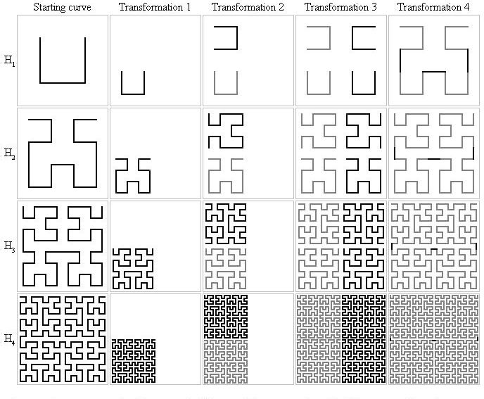
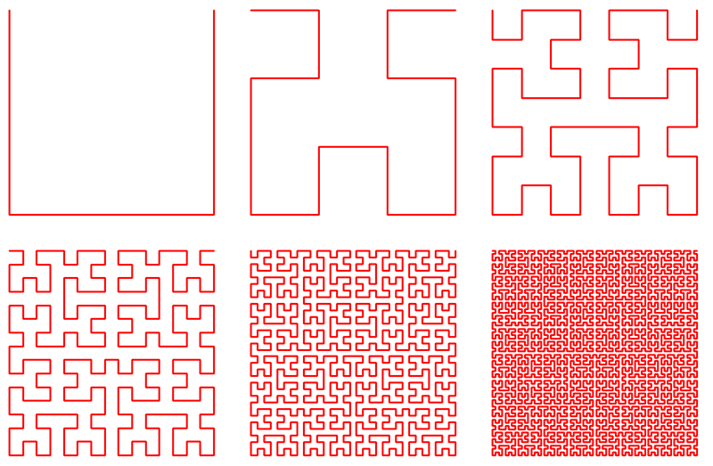
Space filling curve
A space filling curve (SFC) is a 1-D curve that passes through all the points in a discrete / continuous space.
SFC’s have good locality properties, i.e. nearby points in the SFC are nearby in space, and usually vice versa.
Many types of SFC’s, e.g. Morton (Z-order) and Hilbert curves.
SFC’s can be generalized to higher dimensions.

Slide 21
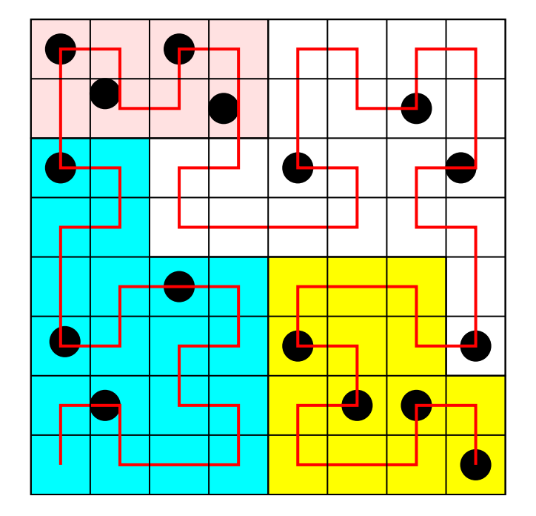
Space filling curve partitioning
We can use an SFC to map nodes onto a 1D line.
Then we partition nodes along the line evenly.
Given a node, there are efficient algorithms to determine which partition it lies in.
Given a box, can also efficiently enumerate all nodes lying inside the box.
These operations are useful for particle simulations and collision detection.

Slide 22
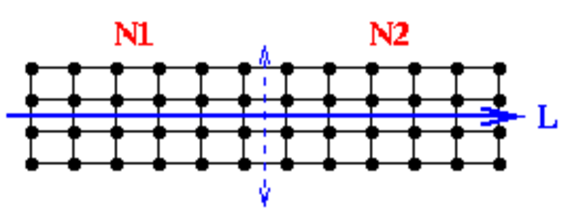
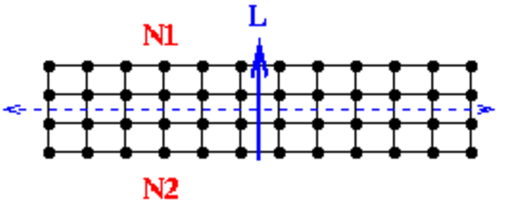
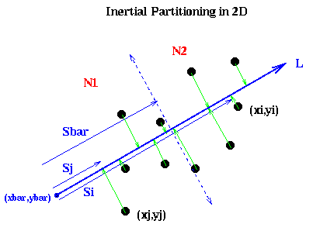
Inertial partitioning
The top partitioning (across the dotted line) is better than the bottom one, because it cuts fewer communicating pairs of nodes.
Intuitively, we want to find a line L that minimizes the moment of inertia of the nodes rotating around L.
A closed form solution exists for the optimal L.
Once we have L, project all the nodes onto L, then find the median.
Partition nodes based on which side of the median their projection lies.
This produces two partitions. For m partitions, apply the partitioning recursively.
Source: https://people.eecs.berkeley.edu/
~demmel/cs267/lecture18/lecture18.html

Slide 23
Graph based partitioning
In geometric partitioning, the communicating tasks were defined implicitly based on proximity.
In graph based partitioning, we’re given an explicit graph showing the pairs of communicating nodes.
Graph nodes can be weighted based on size of the task.
Graph edges can be weighted based on amount of communication.
Want to partition nodes of graph in two parts, and map each part onto a processor.
If we have more than two processors, do the partitioning recursively.
Want each part to have approximately same number / weight of nodes, for load balance.
Want to minimize number of edges cut (i.e. crossing between partitions), because these represent communication between processors.

Slide 24
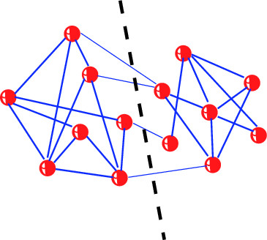
Graph based partitioning
Computing optimal partitioning is NP-complete, so we have to settle for heuristics.
Local search (e.g. Kernighan-Lin).
Spectral.
Multilevel.

Slide 25
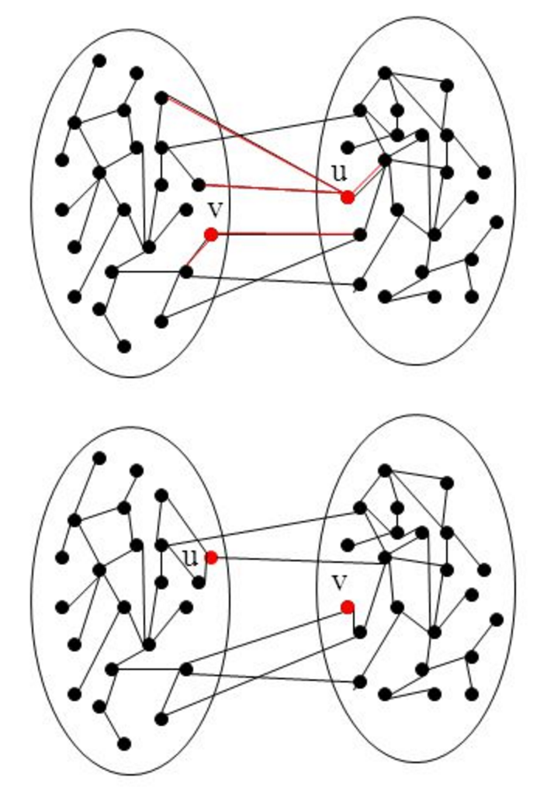
Kernighan-Lin partitioning
Greedily improve a partition by swapping nodes until no improvement possible.
Start with an arbitrary partition A, B.
For n/2 iterations.
Choose a_{i}∈A and b_{i}∈B s.t. a_{i} and b_{i} have never been swapped before, and swapping a_{i} and b_{i} results in smallest cut.
Note that the cut after swapping a_{i} and b_{i} may be larger than the cut (A, B).
Let C_{i} be the cost of the partition after swapping a_{i} and b_{i}.
Choose the C_{i} with the lowest cost.
If C_{i}’s cost is lower than cost of (A, B), restart the algorithm with partition C_{i}.
Otherwise return C_{i}.
In practice KL is very fast and returns reasonably good partitions.

Slide 26
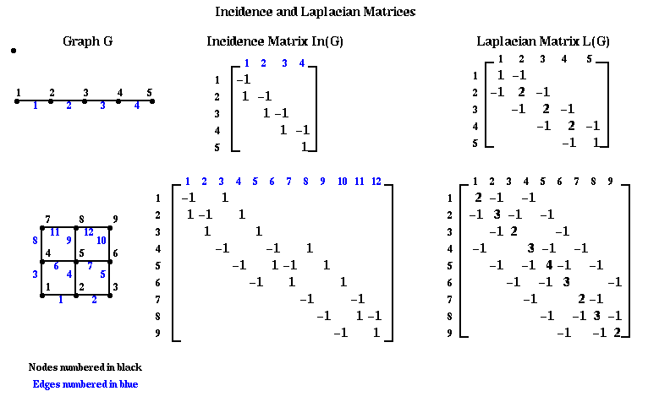
Graph Laplacian
Given an undirected graph G, define the Laplacian matrix L(G)
For each edge (i,j) in G, set entry (i,j) to -1 in L(G).
For each node i, set entry (i,i) of L(G) to –d, where d is the degree of i.
Set all other entries to 0.
Similar to adjacency matrix, but has interesting spectral properties.
Source: https://people.eecs.berkeley.edu/~demmel/cs267/lecture18/lecture18.html

Slide 27
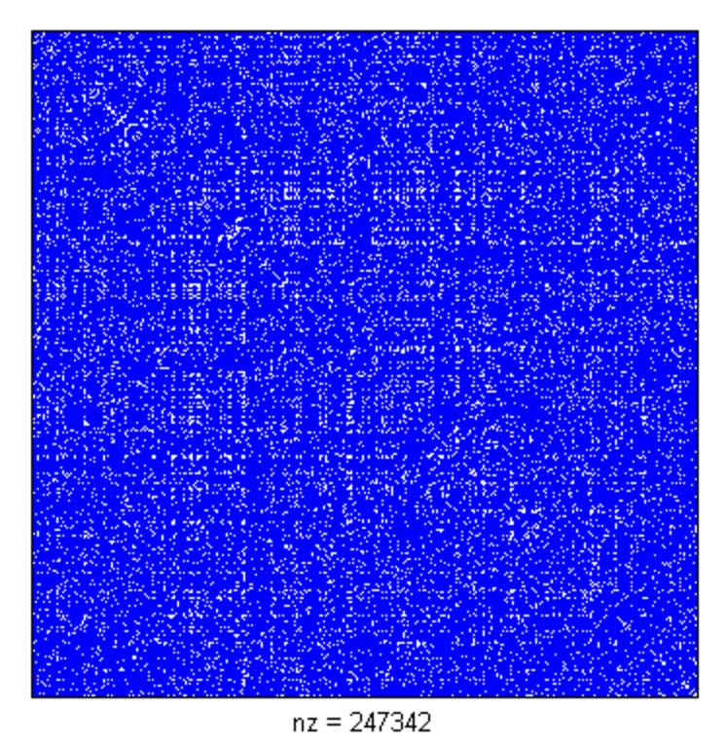
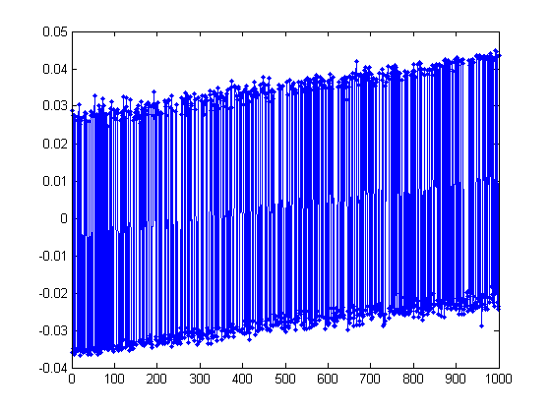
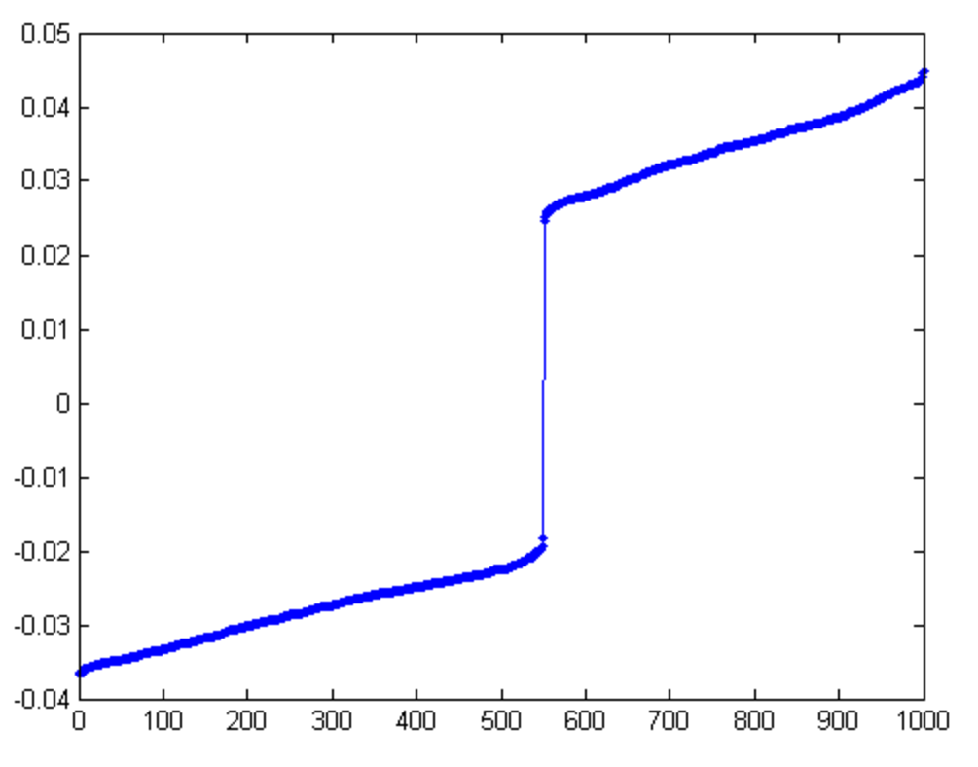
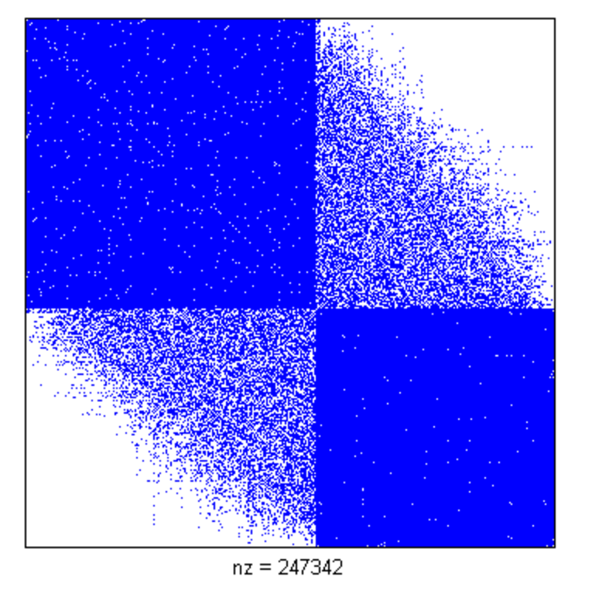
Spectral partitioning
Fact L(G) is positive semidefinite, and all the eigenvalues of L(G) are real and nonnegative.
Let (x₁, x₂, ..., x_{n}) be the eigenvector of L(G) corresponding to the second smallest eigenvalue.
Partition G as A = {i : x_{i} ≤ 0} and B = {i : x_{i} > 0}.
Usually produces better partitions than Kernighan-Lin.
But finding second eigenvector quite expensive.
Suffices to find approximate eigenvector. But this is still costly.
Source: https://www.cs.purdue.edu/homes/
dgleich/demos/matlab/spectral/spectral.html

Slide 28
Multilevel partitioning
Spectral, and even KL partitioning are too slow on very large graphs.
To speed them up we run them on coarsened versions of the task graph.
In fact, we coarsen the graph several times, until the number of nodes is small. Then we partition the coarse graph. Finally, we recover a partition on the fine graph using the coarse partition.
During the recovery, we can refine the coarse partitioning, by e.g. using it as the starting guess for Kernighan-Lin.
Multilevel schemes achieve good quality and speed in practice.

Slide 29
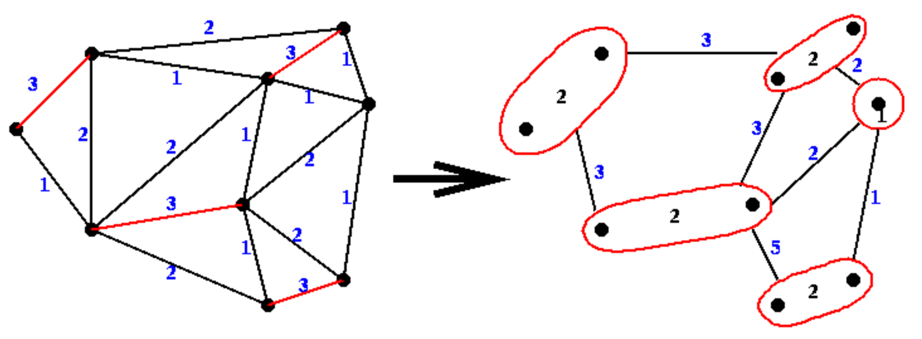
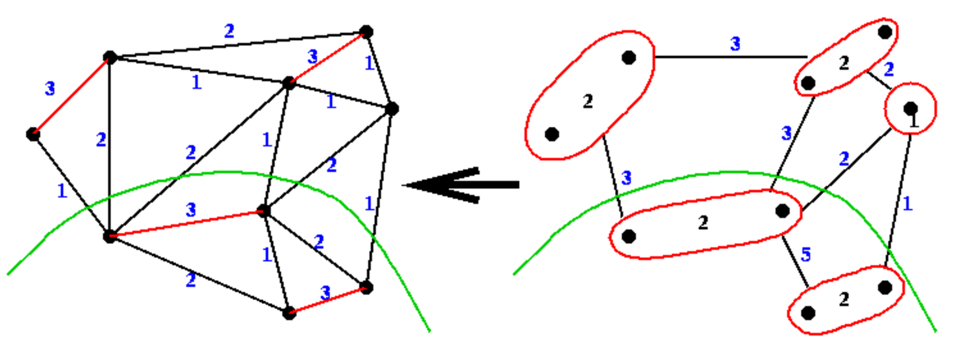
Multilevel partitioning
One way to coarsen a graph is based on matchings.
First, find a maximal matching greedily.
Collapse matched nodes.
Merge edges connected to matched nodes.
After partitioning the coarse graph, expand the merged edges to recover partition in the original graph.
Can refine the partition using e.g. Kernighan-Lin.
Source: https://people.eecs.berkeley.edu/~demmel/cs267/lecture18/lecture18.html

Slide 30
Dynamic load balancing
In some applications tasks are created by processes dynamically.
Ex Search algorithms. Recursive algorithms.
Ideally do distributed load balancing, since tasks are created by distributed processes.
One method is diffusion. If a process has too many tasks, it sends some to its neighbors. If a neighbor becomes overloaded, it does the same thing.
Eventually load spreads out and equalizes.
But might take a long time and cause lots of communication.

Slide 31
Dynamic load balancing
Another technique is work stealing, where processes without work steal work from processes with.
In work stealing, each process maintains a double-ended queue (deque).
Process performs task on the top of the deque.
If process creates a task, it pushes it onto top of the deque.
If the process’s deque is empty, it needs to load balance.
It picks a random other process and steals a task from the bottom of that process’s deque.
This minimizes (but doesn’t completely avoid) contention between the two processes, since one takes tasks from top and one from bottom.
Work stealing doesn’t incur any overhead when processes have tasks.
Overhead when stealing is also borne by idle processes.
In contrast, for work pushing busy processes incur overhead for load balancing.
Work stealing is used in the Cilk parallel runtime.

